Slide 1

Mental Health App
Amigo
A Mind Companion

Slide 2







The Team
Lunatic Bytes
Preetham PN
Smriti Krishnan
Sahal Ali
William Jude Antony
Model Engineering College
Model Engineering College
Model Engineering College
Model Engineering College

Slide 3
ABSTRACT
Mental illness constitutes one-sixth of all health-related disorders.
Lack of support is the main reason for mental illness becoming more dangerous and even leading to suicides.
Amigo, is a personal medical assistant which aims at improving the mental health of the user through various interactive features. Moreover, it also improves the sleep pattern and helps in stress relief.

Slide 4

Helps the user to maintain good mental health.
MOTO
Gives primary guidance, solutions and mental health tests.
Provides helplines to share and cure their issues.

Slide 5
PROBLEM STATEMENT
Mental health is a rising yet sensitive issue which needs to be tackled in the right ways. Not everyone can afford medical appointments in the hospital and thus, the need of an economical personal medical health companion arises.

Slide 6
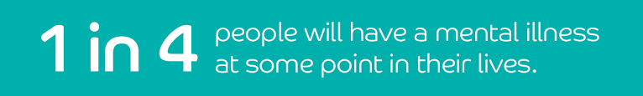
2 Billion
info

Slide 7

The Solution
Give the user a space to be vocal about their problems
Track their development and growth
Helplines to connect to professional doctors in their respective areas
Provide a wider arena of features to maintain good mental health and sleep

Slide 8
Mental Health Tracker
Journaling
FEATURES
Helplines
Primary Solutions

Slide 9

The technology:
Flutter + Dart

Slide 10
User Interface

Slide 11
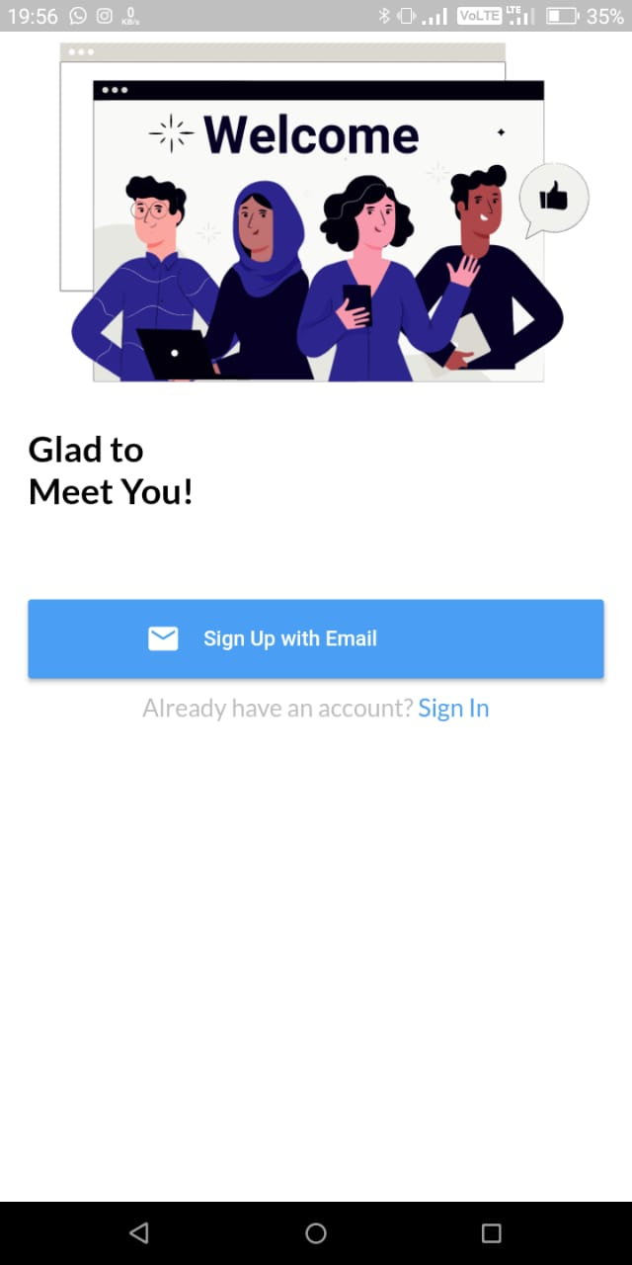
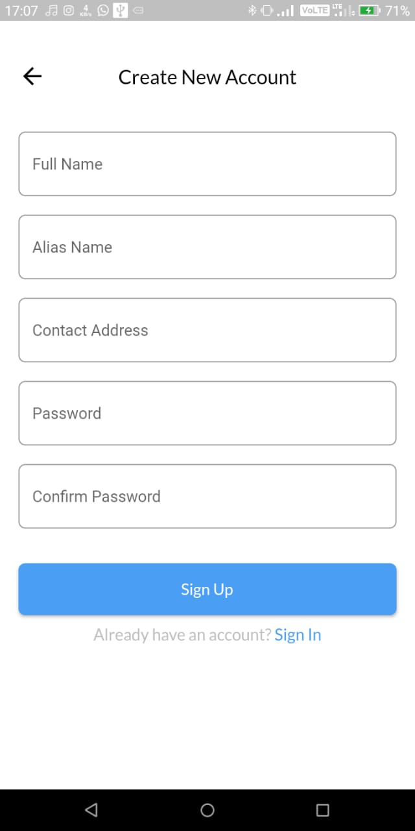
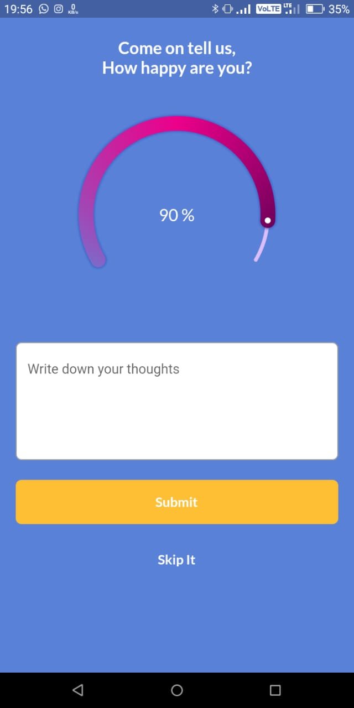
UI

Slide 12
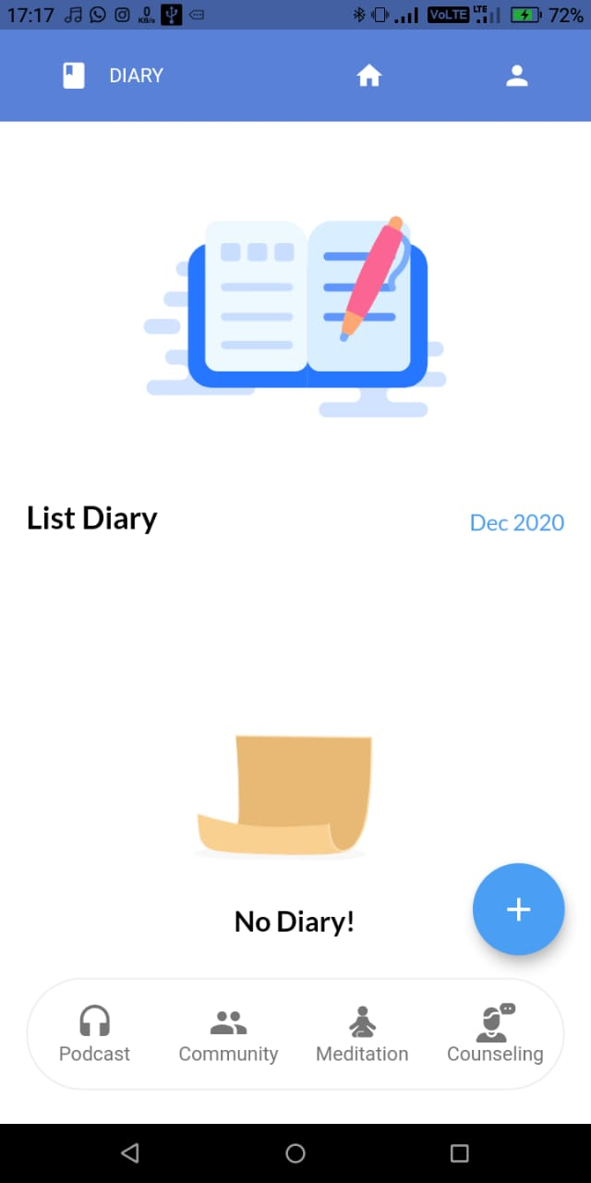
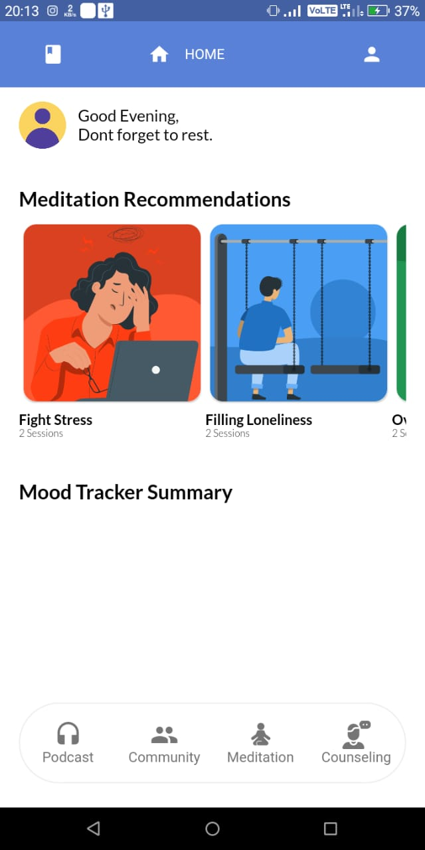
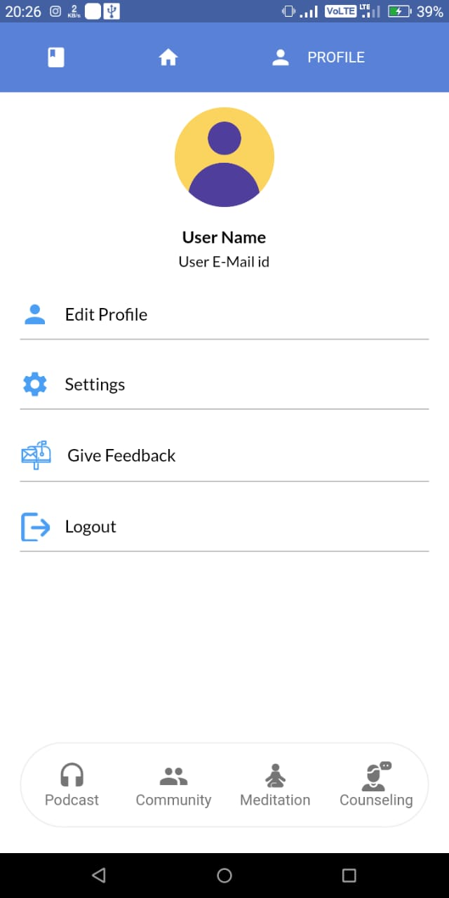
UI

Slide 13
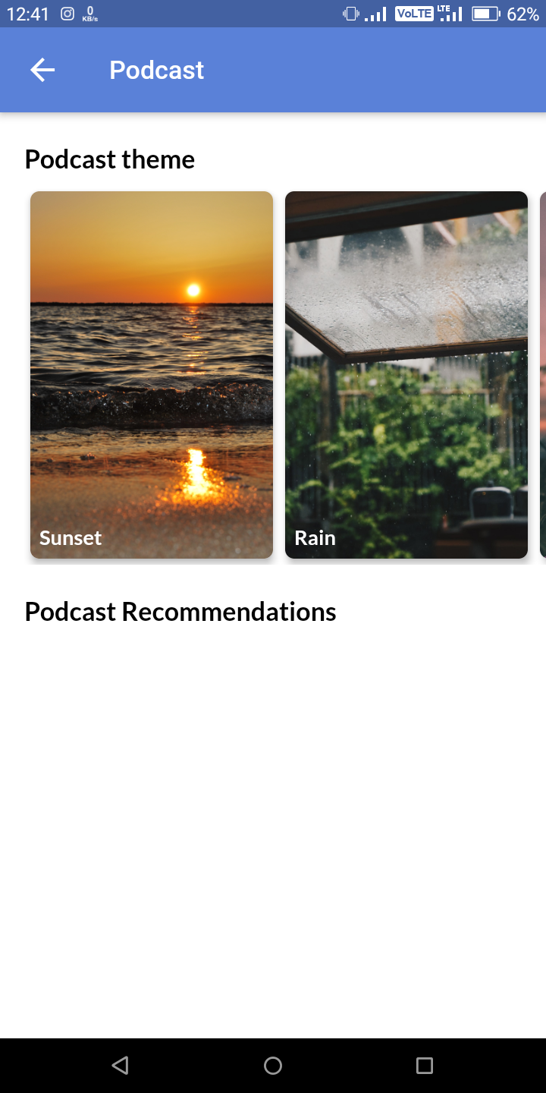
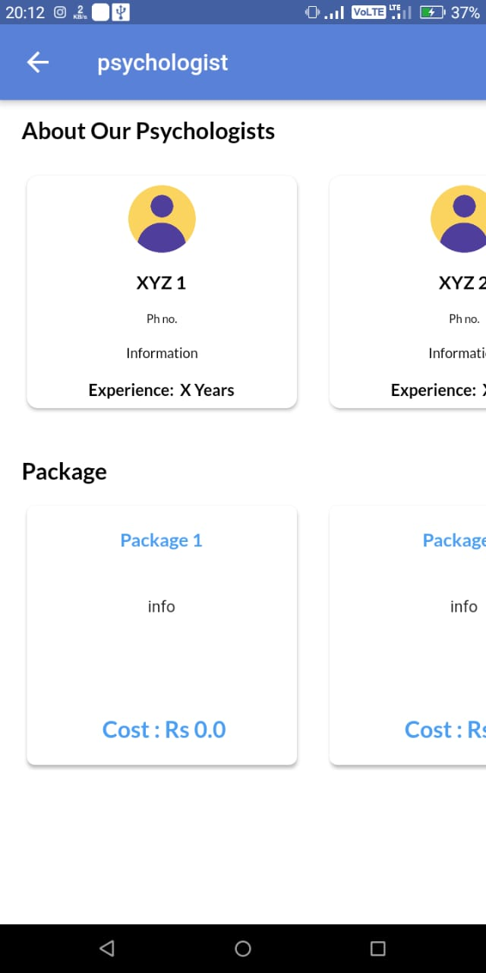
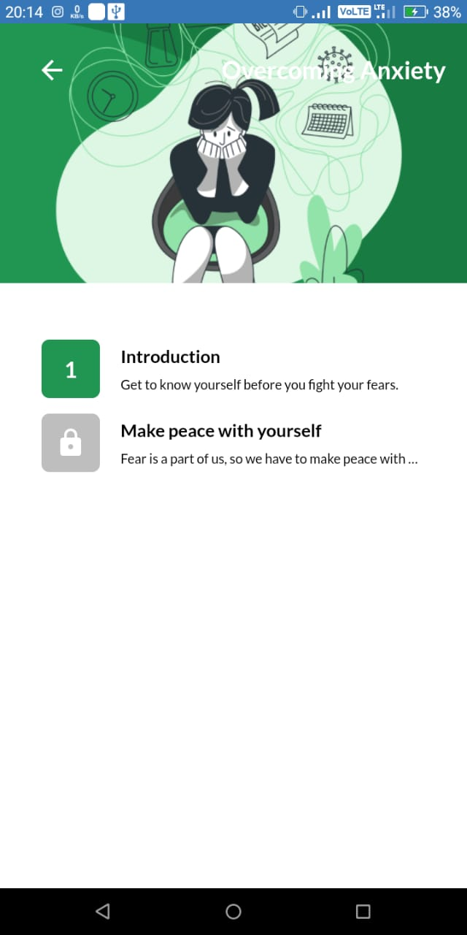
UI

Slide 14
SWOT ANALYSIS
S
W
O
T
STRENGTHS
WEAKNESSES
Improves Mental health
Improves sleep quality
Immediate support at the point of need
Continuous usage of electronic gadgets, increased screen time
OPPORTUNITIES
THREATS
Open music sources
Mental health organisations
More popular mental health applications
Publicizing globally

Slide 15

Our Vision
The features, content and motive behind the application makes Amigo different from the other options available. Almost everything that one could imagine in a mental health application have been involved keeping user safety and convenience as highlights.
Making Amigo a global application will certainly bring changes in the world mental illness count
The main aim is to make the application widely available, accessible and beneficial.

Slide 16
Thank you !!!

